Slide 1
Networking Foundations

Slide 2
Contents
1. Kick-off: a very quick, high-level view
2. Management of Complexity
3. Open Systems Interconnection
4. End-to-end principle
5. Network Topologies
6. Data structures in communication over the Internet

Slide 3
1. Kick-off: a very quick, high-level view

Slide 4
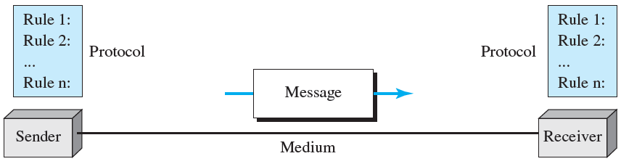
Five components of a data communications system
Notes:
Figure 1.1 of Forouzan’s book

Slide 5
Three network criteria
Performance
Core concern is with quality of operation
Transit time
Response time
Reliability
Core concern is with continuity of operation
Many measures of reliability: MTTF, failure rate, mean number of failures
Normalized MTTF, which takes duty cycle into account, enables cross-system comparison
Security
Core concern is with prevention of unauthorized access to data
Notes:
MTTF: mean time to failure

Slide 6
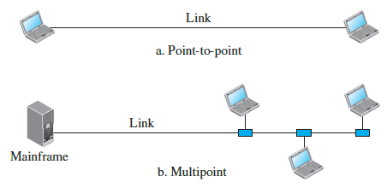
A first look at physical aspects
What is a network?
Two or more devices connected through links.
So, what is a link?
A link is a communications pathway that transfers data from one device on the link to another device on the link
Basic physical link classification:
point-to-point
multipoint
Notes:
Graphic is from Figure 1.3 in your textbook

Slide 7
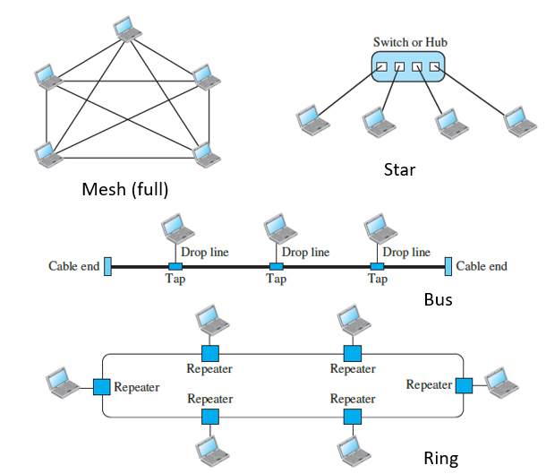
Topology – but of the physical aspect for now
The core concept of topology is the knowledge of how to lay things out.
Physical topology is simpler to grasp as we can sense (usually by seeing) that the things are laid out as we describe them.
Four basic topologies, shown on the right

Slide 8
LAN vs WAN – core difference
LAN:
privately owned, by an enterprise, or on a smaller scale, by a household.
Geographical scope is that of a single building.
WAN:
Geographically separated buildings owned by a single enterprise, or by partners dealing with one another, are connected through the service provided by public network providers.
Notes:
LAN: local area network
WAN: wide area network

Slide 9
Differentiating between internet & Internet
When two physically isolated networks, say, in a building (for simplicity’s sake), are joined, what do we call the resulting structure?
An internetwork!
Or internet
What is the largest internetwork that humanity has built?
That which we call the Internet – which we implicitly assume, today, will serve as the means to connect us to information and entertainment services.

Slide 10
Diversity of technologies
The Internet - made up of:
different networks,
inside independent organizations,
using independent networking protocols.
The purpose of interconnecting all these networks is to enable¹ users on any of them to communicate with users on all the other networks.
This means allowing each device to send and receive packets to/from all other connected nodes.
Notes:
1. Security dictates which users can actually communicate.

Slide 11
Convergence of diversity
The network layer in the Internet is the layer of convergence of all this diversity.
It provides best effort datagram delivery from source to destination, without regard to whether these machines are on the same network or whether there are other networks in between them.
Several network layer protocols (e.g., IPX, VINES Internet Protocol) have been used, but the Internet Protocol (IP) has displaced the rest.
There are two versions of IP: IPv4 and IPv6

Slide 12
Connection vs circuit
A connection is primarily a means to guarantee reliability.
When two parties establish a connection, they keep track of what has been communicated.
Therefore, reliability through tracking of data is the key differentiator.
On the other hand, a circuit is primarily a means of guaranteeing a channel between the two parties.
A circuit is subject to data loss, even though it guarantees a channel (e.g., through interference, or through overflow of a receiver’s buffers).
A connection is subject to extreme variability in the quality of the communication pathway between the endpoints.

Slide 13
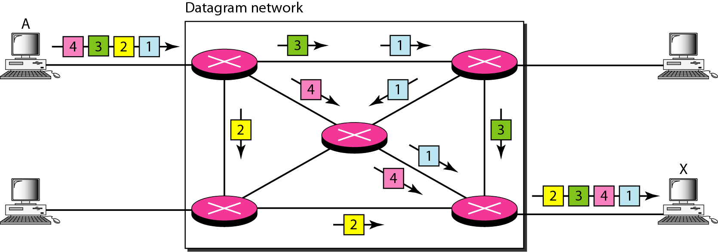
The Internet is a Connectionless Network …
… because IP is connectionless.
IP does not keep track of what has been communicated.
Notes:
The packets do not necessarily arrive in the same order as that in which they departed because : there is no virtual or physical connection that ensures ordered delivery of packets to the network layer’s agent at the destination. the network layer is connectionless

Slide 14
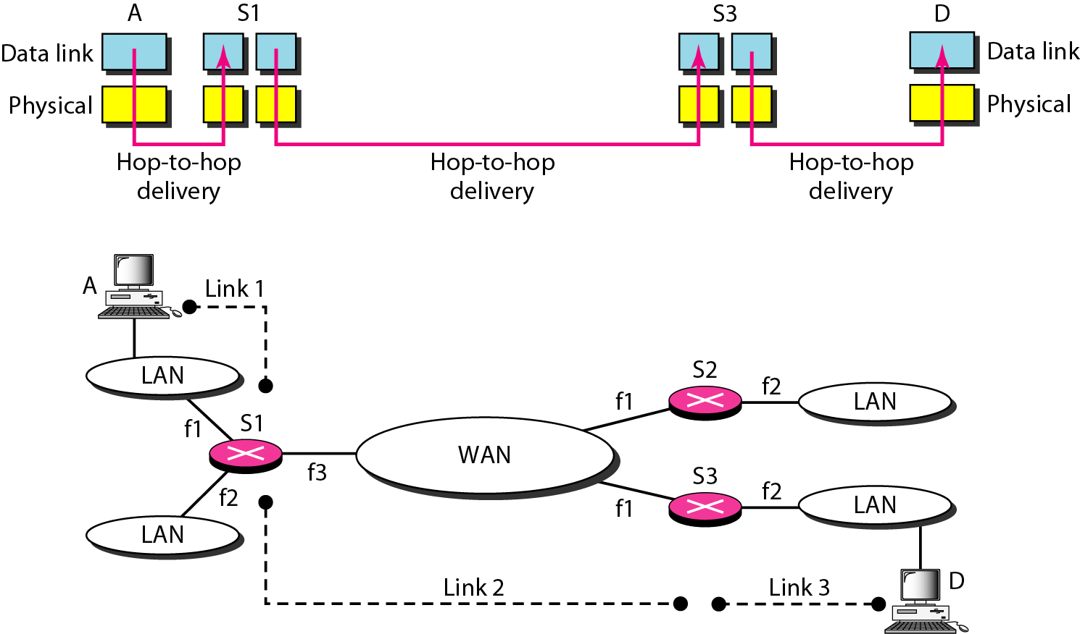
Hop-to-hop Delivery
The physical and data link layer are jointly responsible for hop-to-hop delivery
Note: “Link 2” is obtained through abstraction of the WAN network.
Notes:
The term "hop" in networking commonly refers to a single leg or segment of the journey that a data packet takes as it moves from one device to another across a network. In most networking literature, "hop" traditionally describes the passage of a packet between two devices, typically routers, in the context of IP networks. However, the term can be extended to mean any network device involved in forwarding packets, including hosts and routers.
In Behrouz Forouzan’s usage, referring to a hop as a "host or router" (6th edition, page 18) feels awkward, and it risks confusing the reader, because it blurs the distinction between the link or segment traversed (the actual hop) and the nodes at the endpoints. A more precise phrasing would define a hop as the traversal between two directly connected devices, rather than the devices themselves

Slide 15
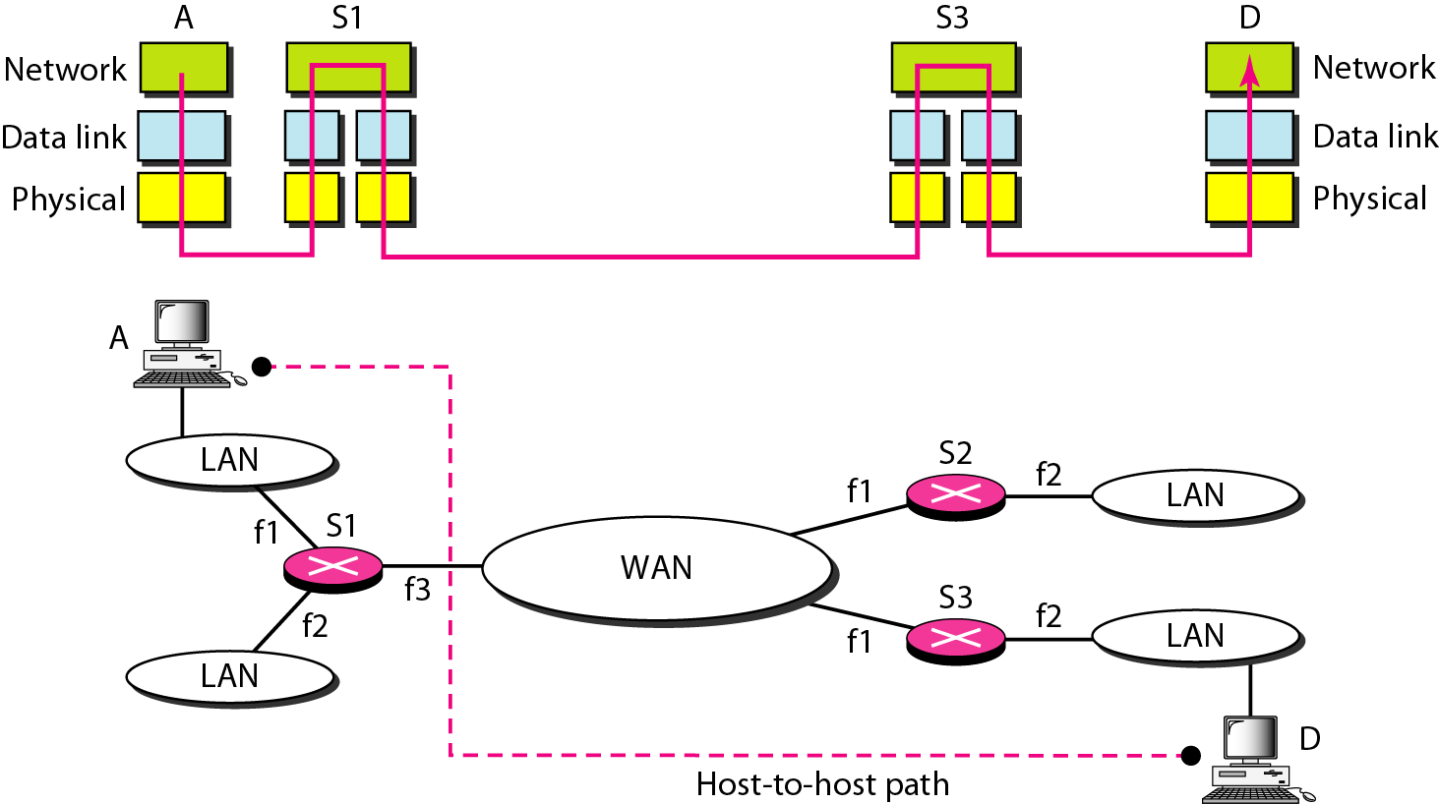
End-to-end Delivery
The network layer is responsible for end-to-end delivery, by routing packets through the intermediate routers.
Notes:
Note that the routers’ links to the various networks are numbered (e.g., f1, f2 and f3 respectively) and the numbering only has local significance. This may be observed when identifying router interfaces using various command-line interfaces such as Cisco’s IOS and Jupiter’s JunOS.

Slide 16
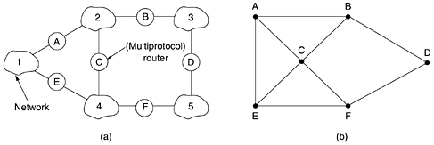
Routing is an inter-network activity
A graph model of the (inter)network is an abstraction of underlying technology, keeping only what is relevant to the routing function.
Router B can directly access A and C through network 2 and can also directly access D through network 3
Routers using link-state routing protocols use this graph to build routes to other routers in the graph.

Slide 17
The Autonomous System
An Autonomous System (AS) can be defined as a collection of connected Internet Protocol (IP) routing prefixes under the control of one or more network operators that presents a common, clearly defined routing policy to the Internet [1].
An Interior Gateway Protocol (IGP) is used for communication within the same AS
An Exterior Gateway Protocol (EGP) is used for communication between ASes
Notes:
[1] RFC 1930, “Guidelines for creation, selection, and registration of an Autonomous System (AS)“

Slide 18

Hierarchical relationships in networking
Analogy
Networks : Internetwork :: Subnets : Network
Similarity
Both are hierarchical: higher-level entity is a collection of lower-level entities, connected via Layer 3.
Difference
Subnets → Network: within a single autonomous system (AS) Networks → Internetwork: often spans multiple autonomous systems

Slide 19
Networks – internetworks, subnets - networks
The relationship between networks and internetwork is similar to that between subnets and network.
Major similarity, major difference:
SIMILARITY
Both are the same type of hierarchical relationship: an internetwork (network) is a collection of networks (subnets) mutually reachable through the operation of a layer 3 protocol.
DIFFERENCE
Subnets – network is used within the context of an autonomous system, whereas networks – internetwork is used within the context of a group of autonomous systems.

Slide 20
2. A preamble to the OSI model: Management of Complexity
Through abstraction, modularity and well-defined interfaces

Slide 21
Management of Complexity
In science and engineering: research, development, operations and maintenance depend on the management of complexity
Simplification of complex systems reduces problems in these areas to tractable intensities.
Management of complexity is fundamental to any space of human endeavour.
Permits gains in knowledge to be consolidated
Facilitates the exploitation of complexity
Lays foundations for further acquisition of knowledge
Reference architectures simplify complex systems.

Slide 22
Techniques in reference architectures
Abstraction
Well-defined interfaces

Slide 23

Abstraction – process vs product
Abstraction as a process:
A mental operation that forms a new concept by isolating certain features from existing concepts or observations. It works by focusing on essential aspects while ignoring or omitting irrelevant details. It may draw on first principles (axioms, primitive notions) as well as on accumulated concepts.
Abstraction as a product:
The concept obtained through this process is itself called an abstraction.
An abstraction is thus a generalized representation, standing at a higher level of thought than the particulars from which it was derived.

Slide 24
Abstraction, in Computing and Communication
Abstraction is realized by a module – a unit of software or hardware.
The module manages its own hidden details while presenting a simplified interface — this interface is the abstraction.
The interface forms a boundary:
Internals are concealed.
Only selected behaviour and properties are exposed.
Crossing this boundary corresponds to moving between levels of abstraction.

Slide 25
Modularity
ABSTRACTION
(conceptual blueprint)
MODULARITY
(structural offspring)
REFERENCE ARCHITECTURE
(system blueprint)
Modularity is a derivative of abstraction, used to manage complexity.
Smaller, less complex and more manageable building blocks may be aggregated to meet the requirement.
These building blocks may in turn consist of an aggregation of even smaller units.
The reference architecture identifies:
for the scope: a set of building blocks
for each block: its functions and input/output relationships
We can therefore state that reference architectures help us to manage complexity through modularity

Slide 26
The interface (or: input/output relationships)
In the exposition of abstraction, the notion of an interface has been introduced, quite underhandedly.
It was introduced practically as a synonym for boundary.
However: an interface is more than a synonym for boundary: it is a hypernym of a boundary
It marks the separation between two modules (like a boundary)
It marks the relationship between two modules (but more than a boundary)
An interface is an essential component of the product of the process of abstraction.
It is the practical means through which an abstraction is exploited.
The encapsulation conceals the inner details except those parts which are left exposed through the interface.

Slide 27
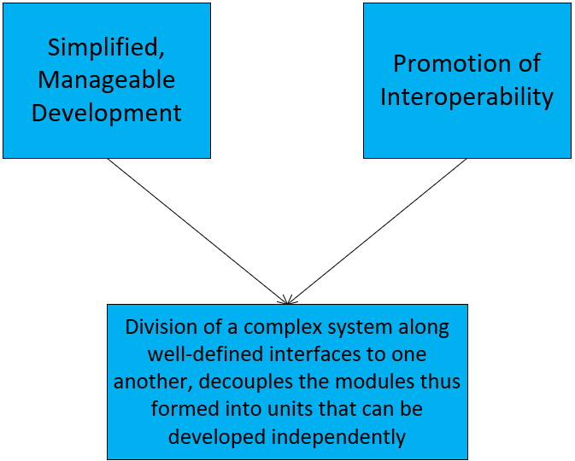
Advantages of well-defined interfaces
Therefore, we can now state that reference architectures help us to manage complexity through well-defined interfaces

Slide 28
Abstraction is iterative
Once an abstraction has been created and the boundary defined, then further simplification may be possible (see note 1).
Each simplification yields a new level of abstraction
Stacking multiple levels produces a hierarchy of abstractions.
If the base resources are hardware resources, as is the case with a mass storage unit (SSD, HDD), then the lowest level of abstraction is implemented in hardware.
The highest level of abstraction is most likely realized in software.
Networking protocol stacks, such as the OSI seven-layer reference model, illustrate this repeated application of abstraction.
Notes:
1. For example, if the bounded entity is used as a component in some organization of components,
then this latter organization may have a boundary and an interface.
Creation of an interface would reduce (simplify) good operation of the organization to compliant behaviour at its interface and
the organization would then have been reduced to a bounded entity with a well-defined interface.

Slide 29
What are we abstracting ?
We abstract the complexity of computer communication through iterative abstraction, producing a stack of nested layers.
Nested layers:
A module at layer N only consumes services¹ from layer N-1.
This design simplifies management and control; without nesting, the stack becomes harder to understand and maintain.
Service consumption rules:
Communication services provided by layer N are accessed at service access points by layer N+1.
Layer N+1 cannot access services of layer N-1 directly; this preserves clean interfaces and modular reasoning.
Notes:
1. This word is a term in the reference architecture, used to indicate part of the interface between layer N and layer N-1. The set of services comprises the interface between the layers.

Slide 30
3. Open Systems Interconnection
A Reference to consult when building Networking Architecture (aka ITU-T X.200, ISO IS 7498)

Slide 31
3.1 Scope

Slide 32
Scope
A standard that addresses interoperability through a template for modelling.
Used to synthesize and analyze layered architectures of communication systems.
The text of the standard is technology-agnostic (context-independent) to enable broad application and therefore enable broad interoperability.

Slide 33
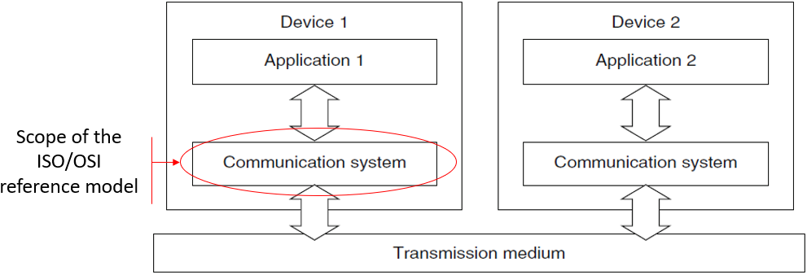
A holistic view of the scope of computer communication
“Each OSI system typically ensures that data from an application process can be transferred to another process.”
“So that application 1 in device 1
can exchange information with application 2 in device 2,
both devices must have their own communication systems,
consisting of hardware and software components.”
This communication system provides the applications
with communication … services
that enable the applications
to carry out their communication requests.” [1]
[1] H. Merz, T. Hansemann and C. Hübner, , “The ISO/OSI Reference Model,” in Building Automation: Communication Systems with EIB/KNX, LON and BACnet, 1st ed. Springer Science & Business Media., 2009, pp.42-43.

Slide 34
3.2 Layers – Nested abstractions

Slide 35
Managing complexity: simplifying communication
The BRM¹ defines seven levels of communication
Layer 1 (lowest, least abstract) → Layer 7 (highest, most abstract).
Layer abstraction
Each layer abstracts all layers below it.
Layer N consumes services only from Layer N-1 – this is the nesting principle
Encapsulation
Conceptual/functional encapsulation: Layer N does not need to know internal functions or protocols of Layer N-1.
Data/operational encapsulation: Layer N-1 encapsulates the PDU from Layer N as its SDU
Semantic independence
Each layer interprets communication at its own level of meaning
Avoids dependence on layers above or below
Notes:
1. Basic Reference Model

Slide 36
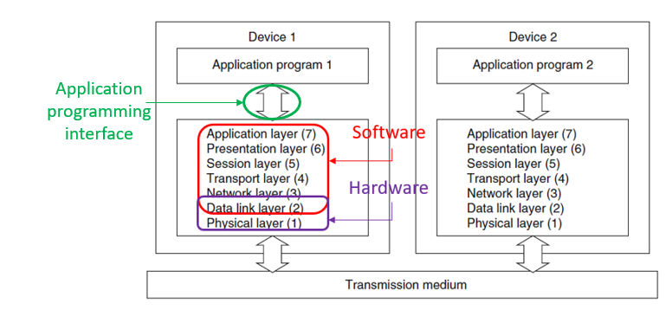
Vertical relationships: Communication Service
Relationship: Layer N ↔ N-1
HIERARCHY OF FUNCTIONS¹
Entity at layer N
(Service User)
Service Access Point
Please send
this data unit
You have
a data unit
Entity at layer N-1
(Service Provider)
Entity at layer N requests delivery service from entity at layer N-1
Many layer N entities may be concurrently active
Content (data contained) is irrelevant to this relationship
As data units move up the layers, progressively more meaning is added.
Full Meaning is communicated across the Application Programming Interface (API).
Generally: physical layer & part of data-link layer implemented in hardware; the rest in software.
Notes:
1. Graphic taken from: H. Merz, T. Hansemann and C. Hübner, , “The ISO/OSI Reference Model,” in Building Automation: Communication Systems with EIB/KNX, LON and BACnet, 1st ed. Springer Science & Business Media., 2009, p.43.

Slide 37
3.3 Connection – mode vs Connectionless – mode services

Slide 38
Services: Connection-mode or Connectionless-mode
“An (N)-layer may offer
a connection-mode service,
a connectionless-mode service,
or both to the (N+1)-layer,
using the service or services provided by the (N-1)-layer .” [1]
[1] Information technology – Open Systems Interconnection – Basic Reference Model: The Basic Model, ISO/IEC 7498-1:1994(E), Nov. 1994.
Notes:
We can therefore conclude that the service offered by the (N-1)-layer is nested within the service offered by the (N)-layer to the (N+1)-layer.

Slide 39
Connection-mode service: definition
“A connection is an association¹ established for the transfer of data between two or more peer-(N)-entities. This association binds the peer-(N)-entities together with the (N-1)-entities in the next lower layer.”[1]
Therefore, in the OSI 7-layer model, connection is defined in terms of:
the peer-(N)-entities
the underlying (N-1)-entities through which the peer-(N)-entities communicate
This is an abstraction that is useful across all the seven layers of the model.
[1] Information technology – Open Systems Interconnection – Basic Reference Model: The Basic Model, ISO/IEC 7498-1:1994(E), Nov. 1994.
Notes:
Note 1
In real terms, an association consists of program code and data structures that exist on each end point of the connection.
The data structures include:
(a) the state of the connection (e.g., alive/dormant/dead and number of data units transferred), as well as
(b) identifiers to uniquely distinguish the connection from other connections.

Slide 40
Connection-mode service: characteristics
A connection’s life cycle passes through three phases:
establishment;
data transfer; and
release
Underlying notion of an agreement:
establishment and maintenance of a two- (or more) party agreement
Agreement is obtained after negotiation, of governing parameters and options of communication.
Agreement is marked by an identifier.
An identifiable connection (via the identifier)supports the sequencing & thus flow-control of data units that are exchanged in the context of the connection.

Slide 41
Connection-mode services: applications¹
“The characteristics of connection-mode transmission are particularly attractive in applications which call for relatively long-lived, stream-oriented interactions between entities in stable configurations” ²
We may therefore find beneficial use cases where:
the exchange of data is comparatively voluminous.
Clarifying by contrast, use cases that accomplish communication with the exchange of a few data units³, gain little to no benefit.
the exchange of data persists over a long period of time.
Clarifying by contrast, notification of an event is unlikely to require more than a one-way dispatch of the event data.
Furthermore, resource reservation on the endpoint entities⁴ is supported by the information obtained during connection establishment.
Notes:
The term “application” here refers to use which can benefit from connection-mode service.
Information technology – Open Systems Interconnection – Basic Reference Model: The Basic Model, ISO/IEC 7498-1:1994(E), Nov. 1994.
Here, the data unit concerned is a packet, structured according to the rules of a protocol at the application layer.
Resources are reserved on the peer-(N)-entities (the endpoints) – not on the mediating network. The latter case – resource reservation on the mediating network – consists of provision of a circuit.

Slide 42
Connectionless-mode services: definition
“Connectionless-mode transmission is the transmission of a single unit of data from a source service-access-point to one or more destination service-access-points without establishing a connection. A connectionless-mode service allows an entity to initiate such a transmission by the performance of a single service access.”^{1,2}
The definition is partly obtained as a complement to the definition of a connection.
Indeed, we shall see that this service’s characteristics and applications are themselves partly complementary to those of the connection-mode service.
Notes:
Do you get the sense that connectionless-mode services facilitate lightweight communication?
Information technology – Open Systems Interconnection – Basic Reference Model: The Basic Model, ISO/IEC 7498-1:1994(E), Nov. 1994.

Slide 43
Connectionless-mode service: characteristics
The atomic operation is the transmission of a single data-unit.
This takes place in a single service access by the (N)-entity to the (N-1) entity.
There is no life cycle.
There is no dynamic¹ agreement between (N-1) entities as a component of the service.
For example, there is no negotiation of quality of service (QoS).
Note: this does not preclude the use of dynamic agreements in underlying layers.²
There is no recurring context – no identifier
The data unit transmitted in this service access has no sequential relationship with other data units transmitted by preceding and succeeding accesses.
This also means that there is no flow control.
Notes:
1. Here, dynamic is used to express something that happens as needed, rather than through prior (static) implementation.
2. For example, communications service providers (CSP) may establish a service-level agreement with a commercial entity for the provision of a Metro Ethernet Forum (MEF) service. This service is connection-oriented.

Slide 44
Connectionless-mode service: applications
Not readily inferred from the BRM.
Even the defined “basic service” is presented as a complement to connection-mode service:
No requirement to expose QoS to the client (higher) layer
No requirement to provide flow control
By complementarity with connection-mode service applications, we may suggest that low-latency, low-volume, sporadic communication applications benefit from connectionless-mode service.
Notes:
1. Real-time transport protocol

Slide 45
3.4 Emergence of Meaning

Slide 46
Semantic Meaning through stacked layers of Function
In Appendix 2, we see that Semantic Meaning in human face-to-face communications emerges only through the function of lower levels.
For example, consider a parent instructing a child.
Physical level:
Verbal communication depends on the articulator apparatus, air (the medium), and auricular apparatus.
Proper function here is prerequisite for the intended effect of the instruction.
Word level:
A common vocabulary is necessary; the parent must speak a language the child understands.
Selecting words is independent of articulating phonemes or hearing them.

Slide 47
Analogizing computer-brokered communication with human face-to-face communication
In the same way as we do not rely on the auricular apparatus and the articulatory apparatus for the full set of levels of function required to communicate meaning ¹…
… neither does a communication system built according to the OSI model, implement a full set of functions in a monolithic system:
“Layers 1 to 6, together with the physical media² for OSI
provide a step-by-step enhancement of
communication services.”
Therefore, communication of Semantic Meaning emerges only at the Application Level through the structural and operational support of a set of levels or layers of function.
Notes:
Apart from the evident separation of mouth and ear (!), there are other regions of the brain that participate in the acquisition of full meaning.
The physical media form part of the mediating network. They are not part of the scope of the OSI 7-layer model, except in so far as that they meet the physical and optical or electrical requirements placed on them.

Slide 48
3.5 The need for Protocol

Slide 49
Horizontal relationships: Communication Protocol
Functions implement communication between entities at the same layer but on different devices.
Communication requires regulation to:
Identify the parties in communication
Synchronize the parties in communication
Preserve order of delivery of fragmented content
Control flow (rate of transmission)
Detect errors in received content
Organize functions like the above five as well as others into phases of communication
Therefore: communication requires protocol.
the functioning of the layers
is governed by OSI protocol standards.” ^{1,2}
Notes:
Note that not all these functions are implemented in every layer. However, there is some functional overlap. In particular error detection is likely to be found in layers 1, 2, 3 and 4.

Slide 50
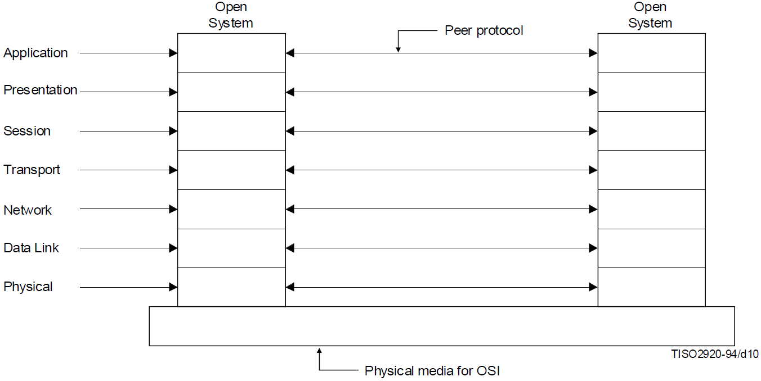
The OSI model’s impact on protocol design
“(i) Allow changes of functions or protocols to be made within a layer without affecting other layers”¹
BRM principle (i) guides us to design protocols that are confined to aspects of communication between peers.
We can now conclude that there may be a need to define protocol for every level of function.
Notes:
1. Information technology – Open Systems Interconnection – Basic Reference Model: The Basic Model, ISO/IEC 7498-1:1994(E), Nov. 1994.

Slide 51
The levels of function (and meaning at these levels)
“(a) Do not create so many layers as to make the system engineering task of describing and integrating the layers more difficult than necessary.” ¹
We can now examine the levels of function that are useful in consideration of computer communication.
Here, the importance of principle (a) emerges:
We are creating a hierarchy to simplify design, production and operation.
We must avoid excessive modularization.
Notes:
1. Information technology – Open Systems Interconnection – Basic Reference Model: The Basic Model, ISO/IEC 7498-1:1994(E), Nov. 1994.

Slide 52
3.6 Understanding the Layers
The services they provide and the functions they include

Slide 53
Key to Characterizing Layers
We have seen that:
a layer has functions¹ and
consumes and/or provides services.
Therefore, the key to characterizing a Layer is to understand:
the services which it provides to the overlying layer;
the functions which it implements within itself;
the use of the services provided by the underlying layer.
Notes:
Remember: a layer’s functions implement the communication particular to the layer. For example: the network layer is primarily responsible for establishing a path from end to end. This primary responsibility can be described in terms of functions:
addressing
routing
notification about errors in attempting to reach the destination

Slide 54
3.6.1 Application Layer

Slide 55
Application Layer: Purpose
Provides the sole means for the application-process to access the OSI Environment (OSIE)
see the right-hand graphic here.
Therefore, the Application Layer provides all OSI services which are directly used by the application-process.
The application-process consumes the services of the OSIE but is not part of it.
Again, here.
We next distinguish between the application process and the application layer entity (ALE).

Slide 56
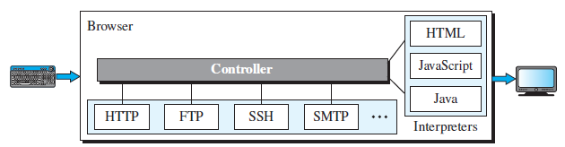
Example: Application Architecture: Browser
This example helps separate application from ALE.
Controller, client protocols, interpreters
Controller:
receives input from keyboard and mouse;
uses a client process (usually running HTTP protocol) to access web page;
uses an interpreter process (e.g., HTML interpreter) to display on screen.
Application Layer Entities

Slide 57
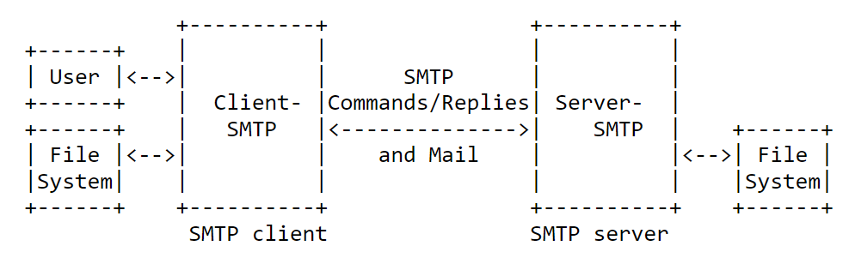
Example: Application layer protocol verbs: SMTP
Mail
User Agent (MUA):
Application
Mail server A (Client-SMTP) wants to send an email to mail server B (Server-SMTP)
Client-SMTP implements the SMTP protocol’s verbs, like:
MAIL FROM: specifies who is sending the email.
RCPT TO: specifies who is to receive the email.
DATA: the actual multi-part content (subject, body, attachments).
ALE
ALE not shown here
Examples:
Webmail MUA: Gmail JavaScript communicating via HTTPS to a backend that handles SMTP
2. Desktop MUA: Mozilla Thunderbird - application and Client-SMTP both run on local computer and communication is via local API calls.
Diagram taken from RFC5321.
Notes:
Regarding the relationship between the mail user agent and the Client-SMTP, RFC5321 states that:
“the means by which a mail message is presented to an SMTP client … is a local matter and is not addressed by this document.”

Slide 58
Application Layer: services provided to user
“In addition to information transfer, [] facilities may include, but are not limited to the following¹:
identification of the intended communication partners (for example by name, by address, by definite description, by generic description);
determination of the acceptable quality of service (for example response time, tolerable error rate, cost vis-a-vis the previous considerations);
synchronization of cooperating applications;
agreement on responsibility for error recovery;
agreement on security aspects (e.g., authentication, access control, data integrity);
selection of mode of dialogue; and
identification of abstract syntaxes.”
Text is taken from OSI standard
Notes:
From RFC5321 (SMTP): “[t]he objective of the Simple Mail Transfer Protocol (SMTP) is to transfer mail reliably and efficiently.”

Slide 59

Example – identification
SMTP (from RFC5321): “The Mail eXchanger mechanisms of the domain name system … are used to identify the appropriate next-hop destination for a message being transported.”
Client side of cloud application: Might use a client-side service registry ALE that invokes a service registry to discover a location of an ephemeral service.
e.g., Netflix Eureka’s microservice architecture
Notes:
ALE: Application Layer Entity
Note that unlike SMTP and DNS, which are both ALEs standardized by the IETF in RFC documents, there is no formal RFC standardizing the service registry ALE, despite its widespread use in various cloud service architectures. This may be due to the speed of development taking place in industry, which is pre-empting formal (de jure) standardization in favour of de facto standardization.

Slide 60

Example – determining acceptable QoS: VoIP vs VoLTE
ALE adopts an adaptive or a negotiating stance
SIP (VoIP ALE) over broadband residential will be adaptive:
RTCP monitors network conditions (e.g., bandwidth, packet loss, latency) and provides feedback to VoIP application;
VoIP application invokes SIP if conditions have crossed thresholds
SIP re-negotiates with its peer, e.g., using a different codec.
SIP in VoLTE will negotiate QoS with the base station’s MAC scheduler
… via the cellular service’s core network.
No need for details here – they’re a bit far beyond foundations.
Notes:
QoS – Quality of Service
SIP – Session Initiation Protocol
VoIP – Voice over IP
RTCP – Real time control protocol
LTE – Long Term Evolution (4G radio access network)
VoLTE – Voice over LTE

Slide 61
Example – Error recovery
SMTP (from RFC5321): “Fully-capable SMTP implementations … are expected to support all of the queuing, retrying, and alternate address functions discussed in this specification.”
FTP (from RFC959): In “block” and “compressed” mode transmission, FTP is capable of error recovery, defined as: “A procedure that allows a user to recover from certain errors such as failure of either host system or transfer process. In FTP, error recovery may involve restarting a file transfer at a given checkpoint”

Slide 62
3.6.2 Presentation Layer

Slide 63
Abstract Syntax
“abstract syntax: The specification of Application-protocol-data-units by using notation rules which are independent of the encoding technique used to represent them.”
i.e., structure and content of data – but not how they will be encoded !
Formal notation commonly used is ASN.1
Describes data structures in a manner independent of encoding
Example: Defining a data structure in ASN.1
An application-layer protocol needs to transmit information about a person
Define structure Person, using ASN.1 as follows:
Person ::= SEQUENCE {
name UTF8String,
age INTEGER,
gender ENUMERATED {male(0), female(1), other(2)}
}
Notes:
ASN.1 – Abstract Syntax Notation One

Slide 64
A note from ASN.1
“Within a real open system, data defined in terms of an abstract syntax will be represented within the local system environment by a local concrete syntax.
A transformation may be necessary between the local concrete syntax and the transfer syntax.
Thus, in communication between real open systems there are three concrete syntax versions of the data:
the concrete syntax used by the originating application-entity,
the concrete syntax used by the receiving application entity, and
the concrete syntax used between the presentation entities (the transfer syntax).
It is clearly possible that any or all of these syntaxes be identical.
The local concrete syntaxes are not visible within the OSIE.”

Slide 65
Abstract vs Concrete Syntax, with examples
ASN.1: REPRESENTING DATA TYPES | JSON: REPRESENTING DATA INSTANCES (not schema) | XML: REPRESENTING DATA INSTANCES (not schema)
Person ::= SEQUENCE { name UTF8String, age INTEGER, gender ENUMERATED {male(0), female(1), other(2)} } | { "Person“: { "name": "Alice", "age": 30, "gender": "female" } } | <Person> <name>Alice</name> <age>30</age> <gender>female</gender> </Person>
Notes:
The objective with ASN.1 is to provide a technology-agnostic definition of a data type.
An instance of this type can then be encoded using whatever encoding rules are convenient.

Slide 66
So … we need the Presentation Layer
An Agent in this layer negotiates transfer syntax with its peer
… relieving the application-layer-entity from concern with what its peer is using.

Slide 67

Examples of Transfer Syntax
The following text comes from ITU-T standard X.680, regarding ASN.1
“ASN.1 … is supplemented by the specification of one or more algorithms called encoding rules that determine the value of the octets¹ used to carry the application semantics (called the transfer syntax)”
Examples
ITU-T Rec. X.690 | ISO/IEC 8825-1 – Basic Encoding Rules (BER)
ITU-T Rec. X.691 | ISO/IEC 8825-2 – Packed Encoding Rules (PER)
ITU-T Rec. X.693 | ISO/IEC 8825-4 – XML Encoding Rules (XER)
Another example is ITU-T Rec. X.697 - JSON encoding rules (JER).
Notes:
1. That is: those octets that are transmitted on the wire!

Slide 68
3.6.3 Session Layer

Slide 69

Session Layer: Purpose
Organization of dialogue
Synchronization of dialogue
Management of data exchange
… in either of connection-mode or connectionless-mode communication

Slide 70

Session Layer Example: SIP
SIP is an application-layer protocol whose functions operate primarily at the session layer.
With some transport-like functions, e.g., sequencing
Manages call setup, teardown, and modification between two endpoints.
Establishes the session (call), negotiates session parameters (e.g., codecs), and manages in-call changes using re-INVITE or UPDATE.
Notes:
SIP: Session Initiation Protocol

Slide 71
Session Layer: Services in Connection Mode
a) session-connection establishment;
b) session-connection release;
c) normal data transfer;
d) expedited data transfer;
e) token management;
f) session-connection synchronization;
g) exception reporting;
h) activity management;
j) typed data transfer; and
k) resynchronization.

Slide 72
… and in connectionless mode:
connectionless-mode transmission using the transport-connectionless-mode service; and
exception reporting.

Slide 73
3.6.4 Transport Layer

Slide 74
Transport Layer: Purpose
“The transport-service provides transparent transfer of data between session-entities and relieves them from any concern with the detailed way in which reliable and cost effective transfer of data is achieved.”
This statement clarifies the earlier reading¹ of limitation of scope of session-layer functions.
The transport layer handles transmission and flow control as a service to the session layer:
transparent,
reliable and
cost-effective² transfer of data.
Notes:
The point to observe here is that despite the session layer’s provision of the services coloured in purple, it is really delegating implementation of the functionality to services which are then implemented as function in the transport layer.
This claim is rooted in the statistical multiplexing inherent to packet-switched networks. This consume-as-you-need approach can offer the best utilization of link capacity, compared to time- or wavelength-/frequency- division multiplexing.

Slide 75
Transport Layer: Congestion Control
“The Transport Layer optimizes the use of the available network-service to provide the performance required by each session-entity at minimum cost. This optimization is achieved within the constraints imposed by the overall demands of all concurrent session-entities and the overall quality and capacity of the network-service available to the Transport Layer.”
An important part of optimization of use is congestion control¹.
E.g. the sender dispatches smaller amounts of unacknowledged data when it detects that data already sent has been lost.
Development of algorithms to improve congestion control recurs in research interest.
Notes:
1. Congestion control regulates the use of a shared medium made by transport-layer entities. In the sense that it regulates use of a shared medium by multiple competing entities, it may be likened to medium access control. Both congestion control and medium access control attempt to obtain fair use of a shared resource through distributed control.

Slide 76
Transport Layer: Services
Connection-mode
“In connection-mode, the following facilities [are] provided by the Transport Layer …
a) transport-connection establishment;
b) transport-connection release;
c) data transfer;
d) expedited data transfer; and
e) suspend facility.”
Connectionless-mode
“When providing the connectionless-mode service, the Transport Layer … maps a request for transmission of a transport-service-data-unit onto a request to the connectionless-mode network-service.”
Notes:
Note that the connectionless mode service is essentially an invocation of a send() function across the layer 4 – layer 3 interface, at the service access point.

Slide 77
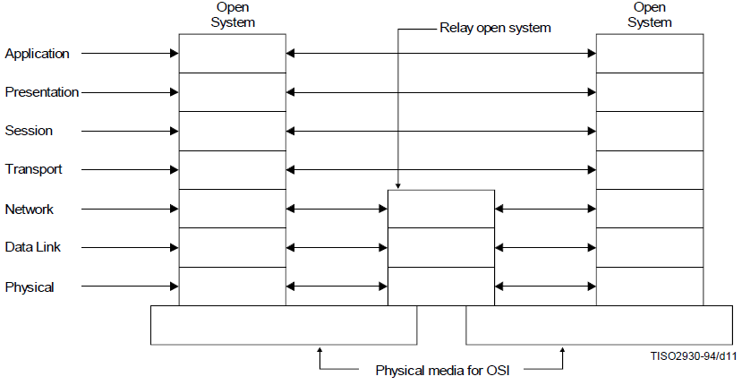
All layers until now are end-to-end
Functions of application, presentation, session and transport layer are executed on end systems in communication.
Intermediate systems (ISs) do not participate in the transport layer or above it.
A good illustration of this paradigm is shown on the right.
This paradigm is fundamental to communication over the Internet.
The reasoning behind the omission of the transport layer from ISs is referred to in RFC1958 & RFC3439:
Network failure would take all end-state information down with it.

Slide 78
Network Layer: Purpose
… is connectionless-mode or connection-mode transmission between end transport-entities
Therefore: frees transport entities from concern with intermediate systems.
The independence from intermediate systems and therefore from network topology is possibly the primary purpose of the network layer.
In turn, underlying data-link connections are abstracted away from the transport entity.
This means that the Transport Layer is independent of the underlying network
Of course, the underlying network must meet QoS requirements!

Slide 79
Network Layer: Core Service
“The basic service of the Network Layer is to provide the transparent transfer of data between transport-entities.”
Compare with the following (seen earlier):
“The transport-service provides transparent transfer of data between session-entities and relieves them from any concern with the detailed way in which reliable and cost-effective transfer of data is achieved.”
This provision of “transparent transfer” requires different functions from the respective layers:
Network function: establishment of a path through a series of links ¹
Transport function: controlled use of the path formed to avoid congestion (of the network) and overflow (of the receiver’s buffers)
Notes:
Note 1
Establishment of a path is not equivalent to establishment of a permanent or switched communication circuit. This leads us to two considerations.
(a) We are now sufficiently developed in our treatment of the subject to distinguish between packet mode and circuit mode of operation of the network layer.
While both modes of operation are within scope, the statistical multiplexing and granularity of capacity allocation inherent in packet mode of operation, do, in general, improve the utilization (therefore, the efficient usage of capacity) of links in a network.
(b) Paths through the network are dependent upon operation of a routing protocol and routing algorithm. At the individual nodes, the result of proper operation reduces to establishment of a forwarding information base, that permits switching of an incoming packet onto an egress port. This is the limit of guarantee: that a packet will be switched out towards the next hop.

Slide 80
Data Link Layer: Purpose
“The Data Link Layer provides functional and procedural means for connectionless-mode among network-entities, and for connection-mode for the establishment, maintenance, and release [of] data-link-connections among network-entities and for the transfer of data-link-service-data-units. A data-link-connection is built upon one or several physical-connections.”
Conformant to our generalized understanding of service provided by layer-(N)-entities to layer-(N+1)-entities, we see here that the Data Link Layer provides connection-mode or connectionless-mode transmission among network-entities.
Furthermore, the Data Link Layer detects, & possibly corrects errors occurring in the Physical Layer.
E.g., in Ethernet, we will see the use of a frame check sequence using CRC32 (error detection only).
Notes:
Note that the Metro Ethernet Forum specifies connection-mode transmission in three forms of service: E-Line, E-LAN and E-Tree. Therefore, not all link layer operation is connectionless.

Slide 81
Data Link Layer: Services: Core Notion
No explicit core service defined in [1], but we can attempt to suggest one through investigation of the various services shown in [1].
Since:
“The data Link Layer allows exchange of data-link-service-data-units”, and
data-link-addresses are unique at least “within the scope of Open Systems attached to a common Data Link Layer”, and
data link layer supports QoS parameters, such as service availability,
… regardless of mode of transmission, then we may deduce that the core notion of service is identical to that of the network layer.
That is: the transparent transfer of data between network-entities, by the establishment of a link over a set of physical connections.
[1] Information technology – Open Systems Interconnection – Basic Reference Model: The Basic Model, ISO/IEC 7498-1:1994(E), Nov. 1994.

Slide 82
Data Link Layer: Service: Core notion revisited
Since:
“The data Link Layer allows exchange of data-link-service-data-units”, and
data-link-addresses are unique at least “within the scope of Open Systems attached to a common Data Link Layer”, and
such QoS parameters as service availability,
regardless of mode of transmission, then we may deduce that the core notion of service remains the one seen here.
That is: the transparent transfer of data between network-entities, by the establishment of a link over a set of physical connections.

Slide 83
Layer | Purpose | Notes
Application | Supports user applications through services that are recognizable to human users. | FTP and HTTP are both used to transfer files. DNS is used to spare the app developer from the need to remember IP addresses.
Presentation | Establishes the format to use for data communication. | Examples include JER, XER, BER, various video and audio codecs.
Session | Supports applications that communicate in a life cycle’s pattern | A life cycle is a process that has a beginning, activity and an end.
Transport | Relieves session layer entities from concern with transfer of data | The transport layer is the first layer in the OSI model where the primary ontological focus shifts to the management and control of data in terms of byte quantities, marking a transition from the more abstract entities handled in the higher layers.
Network | Abstracts network topology away from overlying transport. | This is the layer where paths are established (e.g., using algorithms or policies) and each participating entity uses the path to establish the egress port for a received packet.
Data link | The data link layer provides mechanisms and programmatic control for reliable data transfer, framing, addressing, and media access, facilitating interaction with the physical layer. | We’ve referred to the mechanisms and programmatic control as “services”. This change of terms is intended to concretize this use of the word “services”.
Physical | This is concerned with signal processing, optical transmission and reception, electrical transmission and reception, signal power and mechanical form factors. | Most physical layer technologies are specified by the IEEE, ITU-T and ITU-R.

Slide 84
4. End-to-end principle

Slide 85
Where to host communicating application functions
With distributed applications, the system hosting any given function in the application can be the object of engineering study.
Broadly, two categories of system interest us: end systems(ES)/nodes (EN), and intermediate systems (IS)/nodes (IN).
The first study¹ of this kind expressed this field of study as the problem of where best to put functions in a communication system.
The study observed that a complete and correct implementation of an application function can only be obtained by hosting the application at the end points of the communication system.
The study further observed that the function should therefore not be implemented in the communication system – i.e., NOT on the hosts we now refer to as IS/IN.
These observations are integrated within the end-to-end principle.
Notes:
1. J. H. Saltzer, D. P. Reed, and D. D. Clark, ‘End-to-end arguments in system design’, ACM Trans. Comput. Syst., vol. 2, no. 4, pp. 277–288, Nov. 1984, doi: 10.1145/357401.357402.

Slide 86
Implications for end-to-end protocol design
An end-to-end protocol is one that supports the proper operation of a function (one or more) in a distributed application.
In order to survive network failure, an end-to-end protocol must not store state in an IN/IS, nor may state about it be stored on an IN/IS.
When state is only stored in endpoints, then loss of an endpoint will result in loss of an instance of the distributed application, as well as state pertinent to the operation of one (or more) of its functions.
This is referred to as shared-fate.
A discussion on the history, current state and future of the principle can be found in RFC 3724.

Slide 87
5. Network Topologies

Slide 88
Topology: some definitions
OED: “A term meaning ‘science of place’, which has been tentatively proposed or used in various senses”
More specifically, 3rd form declared in OED deals with the mathematical sense and 3(d) is the sense which we use:
“the way in which constituent parts are interrelated or arranged.”
Physical Topology
“The term physical topology refers to the way in which a network is laid out physically. Two or more devices connect to a link; two or more links form a topology. The topology of a network is the geometric representation of all the links and linking devices (usually called nodes) to one another.” [1]
“Topology describes the structure of a system in terms of how the devices (nodes) are connected with each other. It is illustrated using network diagrams.” [2]
[1] A. B. Forouzan, “Introduction,” in Data communications & networking (sie). Tata McGraw-Hill Education, 2006, ch. 1, pp. 8-9.
[2] H. Merz, T. Hansemann and C. Hübner, , “Konnex,” in Building Automation: Communication Systems with EIB/KNX, LON and BACnet, 1st ed. Springer Science & Business Media., 2009, p. 65

Slide 89
Physical vs Logical
Let’s refer back to “the way in which constituent parts are interrelated or arranged.”
The full set of “constituent parts” may comprise a full representation of all that is in the network:
tangible, visible, physical parts, e.g. computers, network switches and cables (or wireless channels).
These are physical topologies
On the other hand: the full set of “constituent parts” may comprise only a partial representation of all that is in the network.
These are logical topologies – some physical details are abstracted.

Slide 90
Basic topologies
Include linear (chain) topology with the basic set

Slide 91
Basic topologies (2)
Note that the graphic showing the basic topologies does not commit itself to any formal discipline.
It’s not a diagram from graph theory
It doesn’t distinguish between end-systems/end-nodes/hosts and intermediate-systems/intermediate-nodes.
Let’s take a look at what is generally¹ true about these topologies.
Notes:
1. In the sense: something that is not context-dependent – not in the colloquial sense of sometimes true and sometimes not

Slide 92
Generalized, distinguishing, communication characteristics
Bus
Single communication channel, shared by all nodes
Any node can communicate directly with another node
Therefore: arbitration needed to determine which pair of end points communicates.
Mesh
One communication channel per node-pair
Any node can communicate directly with another node.
Arbitration is not required.
Ring
Any node can communicate directly only with its neighbour.
Unidirectional rings specify which one of the two neighbours.
Star
Any node can communicate directly with another node through an intermediate device.

Slide 93
Problem – Topology at what layer?
The “basic topologies” slide does not refer to the layer of the topology.
Networks consist of multiple layers, with each layer supporting a topology among its peers.
Let’s take the adjacent graphic as an example.
This is a star topology at layer 1 but a multipoint-to-multipoint at layer 2!
Notes:
Resume here 14/3/22

Slide 94
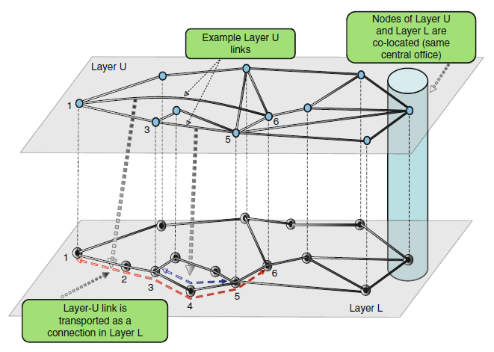
Topology is layer dependent
A more complete network description therefore includes both topology and layer.
Another less well-known example regards the use of packet optical networks.
An underlay, consisting of a ROADM¹ network with interconnecting optic fibres, is populated with some link density over the geographical service area.
An overlay, consisting of (say) layer 3 routers, sees a different mesh than that which is implemented on the underlay (layers 0, 1 and 2).
Graphic from: Doverspike, Robert D., K. K. Ramakrishnan, and Chris Chase. "Structural overview of ISP networks." Guide to Reliable Internet Services and Applications. Springer, London, 2010. 19-93.
Notes:
1. Reconfigurable optical add-drop multiplexer

Slide 95
Some detail pertinent to layer 2 topologies
Bus
Single channel.
Any node can communicate directly with another node over the single channel.
Since there is only one channel, we need arbitration to determine who communicates.
Mesh
Every pair of nodes has a dedicated channel.
Any node can communicate directly with another node.
Since there is one channel per node-pair, arbitration is not required.
Ring
Every node has a dedicated channel with its neighbours only.
Any node can communicate directly only with its neighbours.
Unidirectional rings specify which one of the two neighbours.
Communication might be arbitrated , e.g. taking turns through round-robin sequencing.
Star
Any node can communicate directly with another node through an intermediate device.
Primary benefit is physical convenience in cabling – unlikely to be a topology of layer 2 entities.

Slide 96
Practical topologies: local area, metro area
Local area topology
Ethernet 802.3: physical star topology
Metro area topology
ITU-T G.8032 Ethernet (physical) Ring
The nodes in the graphic are Ethernet switches.
https://www.itu.int/dms_pub/itu-t/oth/06/38/T06380000030003PPTE.ppt
Notes:
What is the link layer topology of the local area network shown?

Slide 97
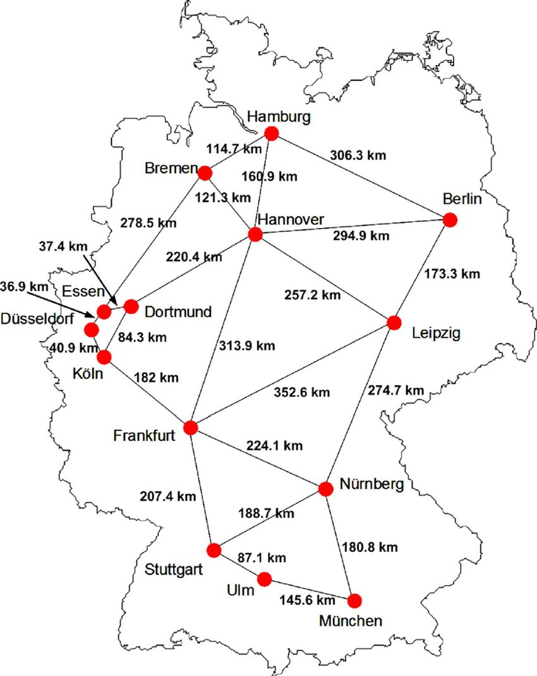
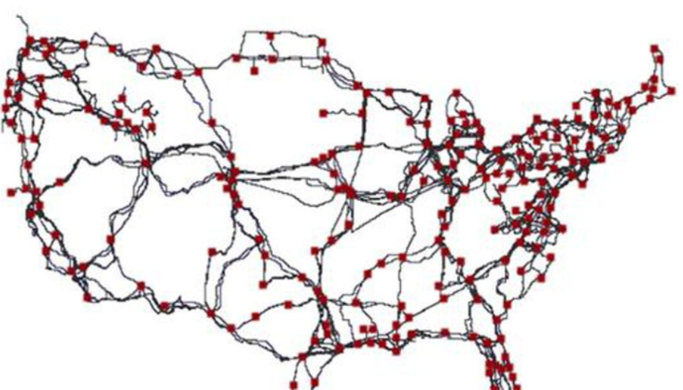
Practical topologies: wide area
Topology and link lengths of the Generic Deutsche Telekom (DT) network.
Topology and link lengths of the USA’s Internet over the span of the country.
S. Azodolmolky et al., "Experimental Demonstration of an Impairment Aware Network Planning and Operation Tool for Transparent/Translucent Optical Networks," in Journal of Lightwave Technology, vol. 29, no. 4, pp. 439-448, Feb.15, 2011, doi: 10.1109/JLT.2010.2091622.
https://www.smithsonianmag.com/smart-news/first-detailed-public-map-us-internet-infrastructure-180956701/

Slide 98
Appendix 1: Foundational packet formats
Used in Communication over the Internet

Slide 99
A1.1 IPv4 Datagram

Slide 100
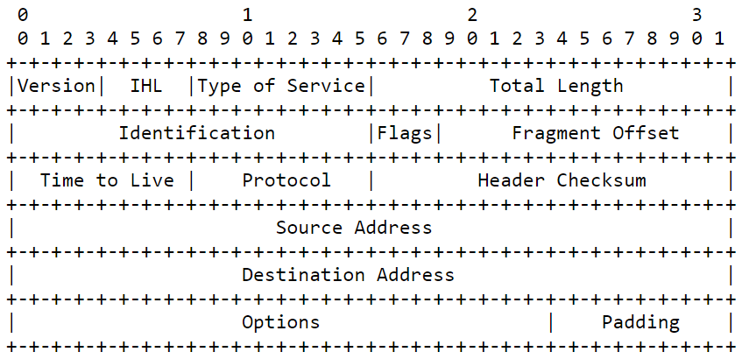
IP v4 datagram header (RFC 791)

Slide 101
1st octet
Set to “0100” as this is IPv4
Header length in 32-bit words (>=5).
First octet on the medium

Slide 102
2nd octet
Used to differentiate services (also known as differentiated services field). This is significant only within the confines of a single service provider’s network, as its practical value is strongly bound to infrastructural facilities and policies.
Notes:
Note that the Metro Ethernet Forum attempts to overcome the locality of significance by proposing this field (the DiffServ field) as a means of exchanging information across provider boundaries about the type of service which has been agreed with the customer in the service level agreement (SLA).

Slide 103
3rd and 4th octets
Length of IP datagram, = header + payload

Slide 104
5th and 6th octets
Identifies datagram fragments to assist reassembly

Slide 105
7th and 8th octets: flags
Used to indicate whether this is a fragment, whether this is the last fragment and to guide an intermediate node (router) as to whether it may fragment or not.

Slide 106
7th and 8th octets: fragment offset
Used to indicate the position of the first octet in the payload within a fragmented total payload.

Slide 107
9th octet: time-to-live (TTL)
A counter that is decremented by one at every intermediate node; if an IN counts down to zero, the datagram is discarded (prevents infinite circulation of datagrams)

Slide 108
10th octet: carried protocol
A signature octet, indicating whether UDP, TCP or some other protocol is in the payload

Slide 109
11th, 12th octets: carried protocol
A checksum computed by every IP-layer IN, since some header fields (e.g. TTL) may change

Slide 110
13th - 20th octets: source, dest. IP addresses
A checksum computed by every IP-layer IN, since some header fields (e.g. TTL) may change

Slide 111
A1.2 Ethernet II frame

Slide 112
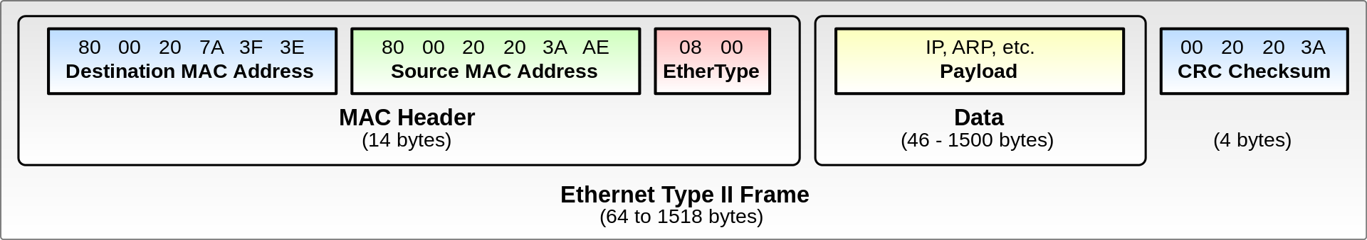
Ethernet Type II Frame
Public Domain, https://commons.wikimedia.org/w/index.php?curid=1546835

Slide 113
Most significant octet of MAC address
U/L bit = 0 means that this MAC address is universally unique
I/G bit = 0 means that this MAC address is a unicast address

Slide 114
Appendix 2: Communicating Meaning
Between Humans; Between Computers

Slide 115
Meaning in Human Communication
Imagine the context of a discussion between two people.
“I” am one of the two people.
When I ask “What do you mean?”, I am seeking to match my understanding to that of the person to whom I place this question.
Without necessarily agreeing (accepting), of course ☺
Therefore Meaning lies at the core of understanding.
We use Words to carry Meaning.
On reception, Words are progressively assembled through Cognitive Processes.
Meaning is Communicated when sufficient assembly has taken place to recognize a Concept.
Therefore, Meaning is formed out of Concepts.
Complex Meaning may require several Concepts, which are linked to comprise the Complex Meaning.

Slide 116
Words are …
Physical
Phones originate in the articulators.
Carried through air (typically!)
Received by the ear
Transported
over the air as a sequence
possibly through a messenger
with requests for repetition by the receiver if a word from the sender is lost
Linked
By projection
By facial interaction
By naming the recipient
Organized into sessions
two people discuss a theme until they drop it and move on to another
Detected
Through understanding of a common vocabulary
Presented according to recipient(s):
to a peer / to someone deferred to,
to a crowd,
in a solemn occasion/festive occasion
Relayed (if necessary)
Through messengers,
who know how to reach the recipient
Applied to life in the family, at work, in sport with context-dependent terms

Slide 117
Attributes of Words’ relationship to Meaning
Words are used to carry meaning.
Therefore, each word carries a part of meaning.
Meaning emerges from words.
The meaning carried by a word is not uniquely bound to it.
Verbosity of meaning.
The meaning carried by a word depends upon the words that surround it (its context).
Context-dependency of words.

Slide 118
Phonemes’ relationship to Meaning
These attributes are even more pronounced at the level of the relationship between individual phonemes and meaning.
Phonemes are cognitive abstractions of phones (the “physical segments”) used to carry words.
The mind stores the phoneme to produce the phone.
Each phone carries a part of the sound of a word.
A phoneme is the smallest structural unit that carries meaning.
Again: meaning emerges from phonemes, rather than inheres to it.
A mis-detected phoneme may lead to detection of the wrong word.
E.g. detect /t/ instead of /d/ and obtain “kit” instead of “kid”.
It is only in the ensemble of phonemes, words, sentences and sometimes longer elements of speech that meaning is communicated.

Slide 119
Meaning in Computer Communication
Just as phonemes, words, clauses, sentences, exist concurrently in human communication but exist at different levels to carry meaning …
… so can we organize computer communication into hierarchical levels.
Between humans, meaning is communicated when concepts are recognized.
Between machines, meaning is communicated when
applications recognize a command,
applications recognize a response, or
an event is received
… across an application programming interface (API).

Slide 120
Assembling Meaning
Meaning is assembled through the accumulation of some number of lower-level units.
With human communication (roughly):
phonemes are assembled into words
words are assembled into sentences
sentences are abstracted into concepts
concepts are rationalized into meaning
With machine communications (simplified):
bit patterns (baseband) / symbols (modulation) are assembled into bit-groups (by processes like decoding)
bit-groups (e.g. octets) are assembled into packets (by packet-length bit-group or packet-end bit-group detection)
packets are assembled into application-level messages (by protocol logic)
application-level messages carry all or part of meaning (by protocol logic)

Slide 121
Appendix 3: Getting a feel for the BRM
The principles expressed in X.200, enumerated

Slide 122
On layers
(a) Do not create so many layers as to make the system engineering task of describing and integrating the layers more difficult than necessary.
(c) Create separate layers to handle functions that are manifestly different in the process performed or the technology involved.
and complementarily:
(d) Collect similar functions into the same layer.
(h) Create a layer where there is a need for a different level of abstraction in the handling of data, for example morphology, syntax, semantics

Slide 123
On boundaries
(b) Create a boundary at a point where the description of services can be small and the number of interactions across the boundary are minimized.
(e) Select boundaries at a point which past experience has demonstrated to be successful.
(g) Create a boundary where it may be useful at some point in time to have the corresponding interface standardized.
(j) create for each layer, boundaries with its upper and lower layer only

Slide 124
On functions
(f) Create a layer of easily localized functions so that the layer could be totally redesigned and its protocols changed in a major way to take advantage of new advances in architectural, hardware or software technology without changing the services expected from and provided to the adjacent layers.
(i) Allow changes of functions or protocols to be made within a layer without affecting other layers; and

Slide 125
Appendix 4: Accessing the Linux kernel’s networking stack
The socket interface

Slide 126
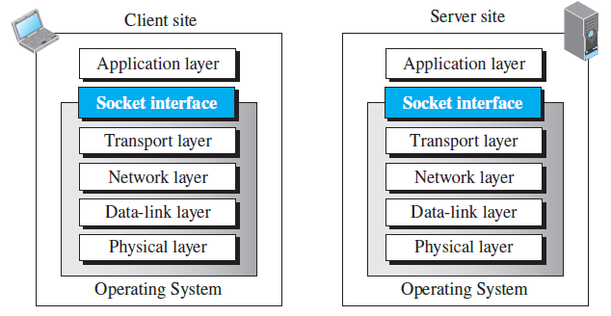
Implementation: Socket Interface
This example diverges a little from the OSI model: it is an implementation based upon the Internet Protocol suite.
The Internet Protocol suite subsumes the Presentation layer and the Session layer within the Application Layer.
The socket interface is a set of instructions that provide communications between the application layer and the operating system.
Notes:
Graphic taken from Fig. 10.4 of Forouzan’s book

Slide 127
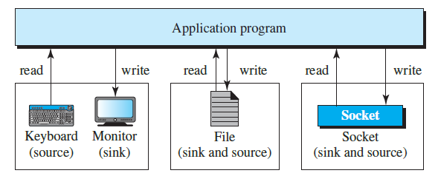
Using sockets
Includes both the ALE(s) and other components of the application’s architecture
The human user interacts with the application through a GUI or CLI.
The application may have one or several concurrent processes.
One of these processes, or a thread within one of these processes, reads and writes using the instructions of the Socket Interface.
As far as the process is concerned, it communicates physically with the Socket.
Notes:
GUI: graphical user interface
CLI: command line interface
Graphic taken from Forouzan, Fig. 10.5

Slide 128
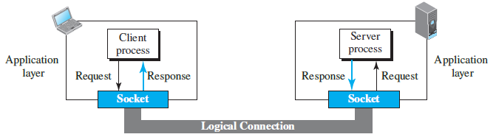
The perspective from the Application Layer
As far as the application layer is concerned, communication between a client process and server process is communication between two sockets.
Client process: socket receives request/needs response
Server process: same

